Slide 1
Using eBPF in Kubernetes
Presenters:
Namratha Kallavi (namkalla@cisco.com)
Kaarthik Sivakumar (kasivaku@cisco.com)
Notes:
Extended Berkeley packet filter

Slide 2
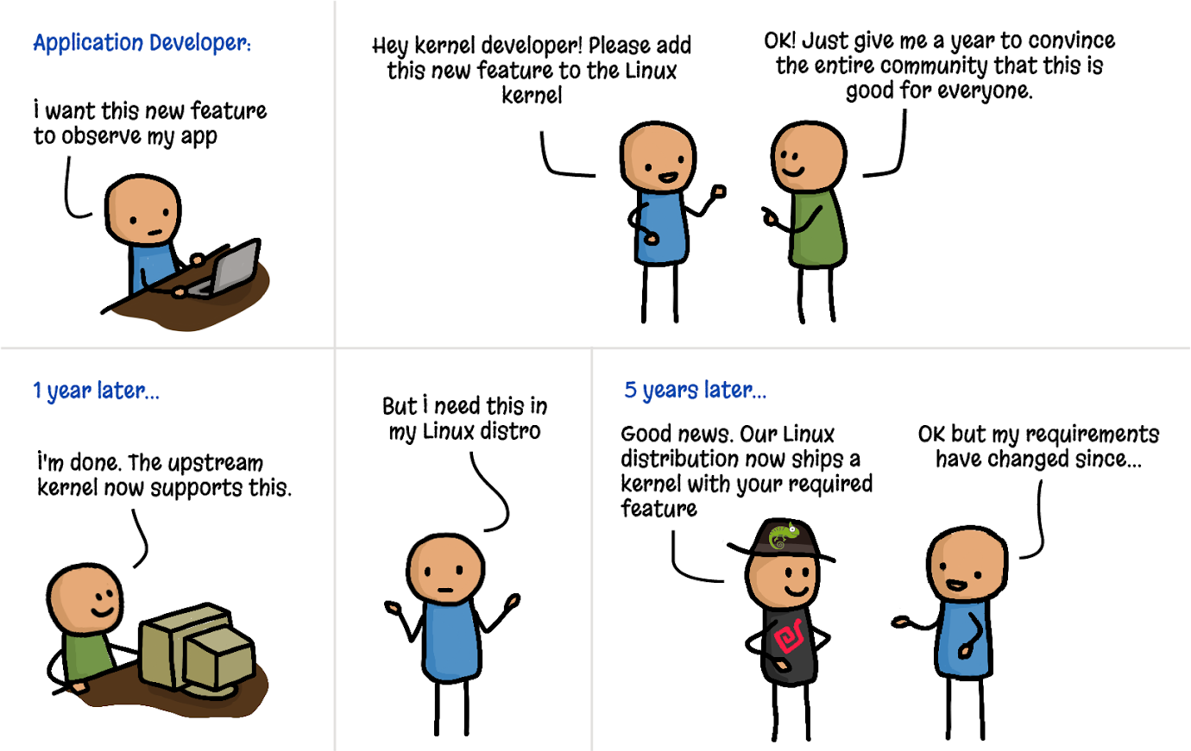
Traditional kernel development cycle

Slide 3

Traditional Linux Kernel Development
To gain new types of access to kernel-level functions, one has the option of waiting for the Linux community to build and approve those new capabilities in the kernel, but this process normally takes many years.
Alternatively, one has the option of modifying the kernel source code in one’s own Linux fork, but this solution is complicated and risky to implement because kernel modifications can pose a serious risk to the stability of a system.
Yet another option would be to write loadable kernel modules (LKMs) to provide the desired functionality. But LKMs are also complex, risky and require constant maintenance because any Linux kernel version upgrade can inadvertently break the module
Notes:
LKMs can be released independent of the kernel release timelines.
LKMs are also not verified. They can potentially crash the kernel.

Slide 4

Unlocking the kernel with eBPF
Introduced in kernel v3.18

Slide 5
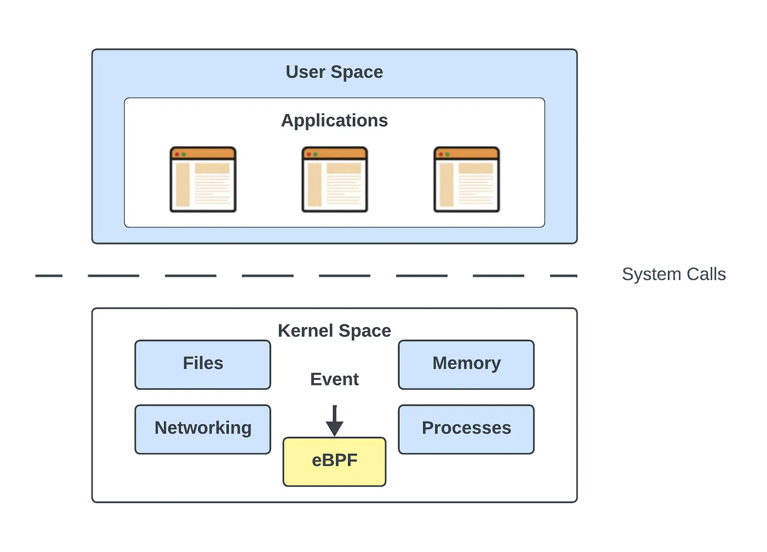
What is eBPF?
eBPF is a revolutionary technology in the Linux kernel that can run sandboxed programs in a privileged context within the kernel. It is used to safely and efficiently extend the capabilities of the kernel without requiring to change kernel source code or load kernel modules.

Slide 6
History of eBPF
BPF, Originally known as BSD Packet Filter deploys a kernel agent, a packet filter, which allows one to process packets at an early stage at the entry point of the networking stack. The BPF Pseudo-Machine, an abstract machine (similar in concept to the Java Virtual Machine), was designed specifically for packet filtering. As this abstract machine serves the purpose of packet filtering exclusively, it operates inside the kernel-space as a kernel agent.
The concept of eBPF was introduced with Linux kernel version 3.18, finding application in areas such as security, tracing, profiling, observability, and monitoring.
Notes:
To establish packet filtering tailored for DDoS protection, including the filtration of packets targeted at specific ports, such as TCP/22 (SSH), one needs to develop a program in the BPF instruction set architecture, specificaly the XDP/BPF Program type. After creating the program, it is loaded using the BPF kernel agent, which then verifies its correctness before attaching it to the relevant socket.
Tcpdump –i lo –A (-A for headers, -I for interface name filtering)

Slide 7
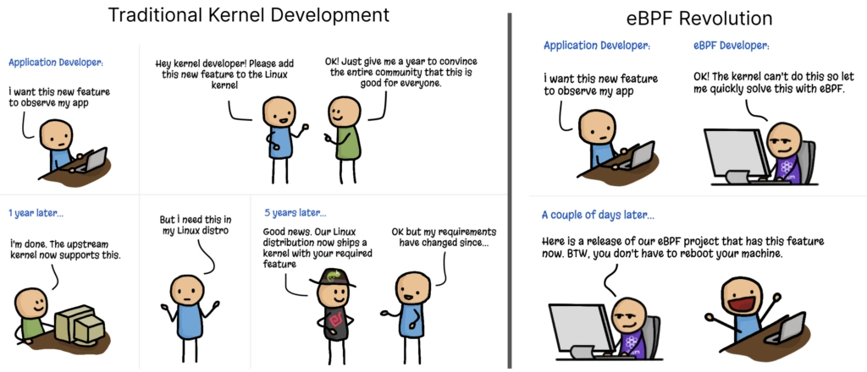
Why eBPF
No need to wait for long kernel dev cycles, or for stable LKMs or to maintain your own Linux branch.

Slide 8

HOW?

Slide 9

Lab-0: Tracing execve() syscall
Sample program to attach a BPF function to exece syscall and track how many syscalls each user makes.
Run the helloworld program and see the following:
bpftool prog show name <>
Xlated: size after translation; adjusted for kernel verifier
Jited: size when ELF was generated
Tag: Program label
loaded_at: Timestamp of prog load
btf_id: BTF (BPF Type Format) is the metadata format which encodes the debug info related to BPF program/map. BTF includes data types, function info for defined subroutines, and line info for source/line information.
Notes:
strace -e bpf ./hello-buffer-config.py
Logs written to /sys/kernel/debug/tracing/trace_pipe (producer-consumer model, user space reads from that pipe as soon as data is available)

Slide 10
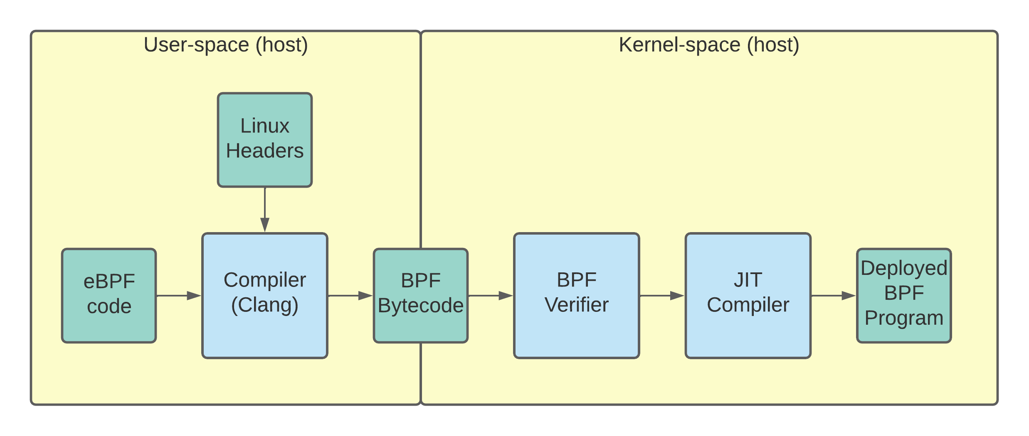
How does eBPF work?
eBPF lets you run programs isolated in an in-kernel execution environment called the eBPF virtual machine (eBPF VM). To prepare an eBPF program to run in this environment, a developer first writes the program, converts the code to intermediary bytecode by using a compiler suite (such as LLVM), identifies a system event (called a “hook”) to attach the program to, and then loads the program into the Linux kernel by using one of the available eBPF libraries.
Once loaded into the kernel, the program is automatically verified through the verification engine, and its bytecode is compiled—via a just-in-time (JIT) compiler—into a machine-specific instruction set.
The eBPF code at this stage is ready to be invoked by the pre-specified hook, such as a system call or network event. After the eBPF code is triggered, it can call special functions called “helpers” that can perform a wide range of tasks, including searching and updating key-value pairs in tables, generating random numbers, redirecting network packets, and more.
Notes:
Execve() is just an example. It could be any kernel syscall, with some restrictions.
For security and stability reasons, these helper functions must be pre-defined by the kernel
https://www.collabora.com/news-and-blog/blog/2019/04/05/an-ebpf-overview-part-1-introduction/
https://lwn.net/Articles/740157/

Slide 11
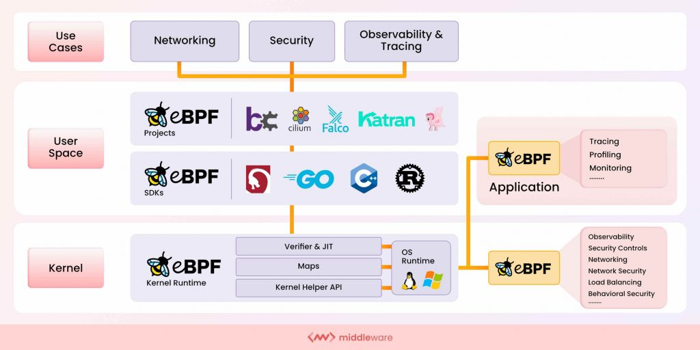
eBPF Hooks
Where can you expect to find an eBPF program attached?
Notes:
(Application of/using eBPF)
Falco: Collect data from multiple sources and detect threats – like k8s audit logs, kernel syscalls, cloud events
Katran: load balancer from Meta
Pixie: observability tool for collecting telemetry data from k8s

Slide 12
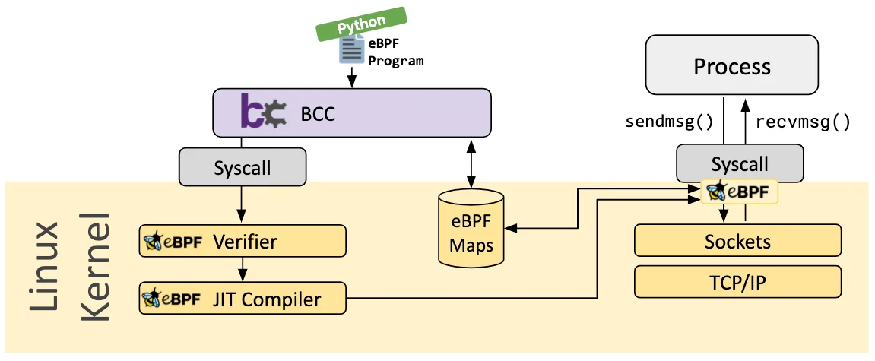
BCC framework
BCC is a framework that enables users to write python programs with eBPF programs embedded inside them.
The framework is primarily targeted for use cases which involve application and system profiling/tracing where an eBPF program is used to collect statistics or generate events and a counterpart in user space collects the data and displays it in a human readable form.
Running the python program will generate the eBPF bytecode and load it into the kernel.

Slide 13
eBPF data structures
Using eBPF maps is a method to keep state between invocations of the eBPF program, and allows sharing data between eBPF kernel programs, and also between kernel and user-space applications.
Store and retrieve data using maps. Map types:
Hash tables, arrays
Maps, array per cpu
LRU hash per cpu
Tables
Histogram etc.
Notes:
enum bpf_map_type { BPF_MAP_TYPE_UNSPEC, BPF_MAP_TYPE_HASH, BPF_MAP_TYPE_ARRAY, BPF_MAP_TYPE_PROG_ARRAY, BPF_MAP_TYPE_PERF_EVENT_ARRAY, BPF_MAP_TYPE_PERCPU_HASH, BPF_MAP_TYPE_PERCPU_ARRAY, BPF_MAP_TYPE_STACK_TRACE, BPF_MAP_TYPE_CGROUP_ARRAY, BPF_MAP_TYPE_LRU_HASH, BPF_MAP_TYPE_LRU_PERCPU_HASH, };
https://prototype-kernel.readthedocs.io/en/latest/bpf/ebpf_maps.html
https://lwn.net/Articles/779120/

Slide 14
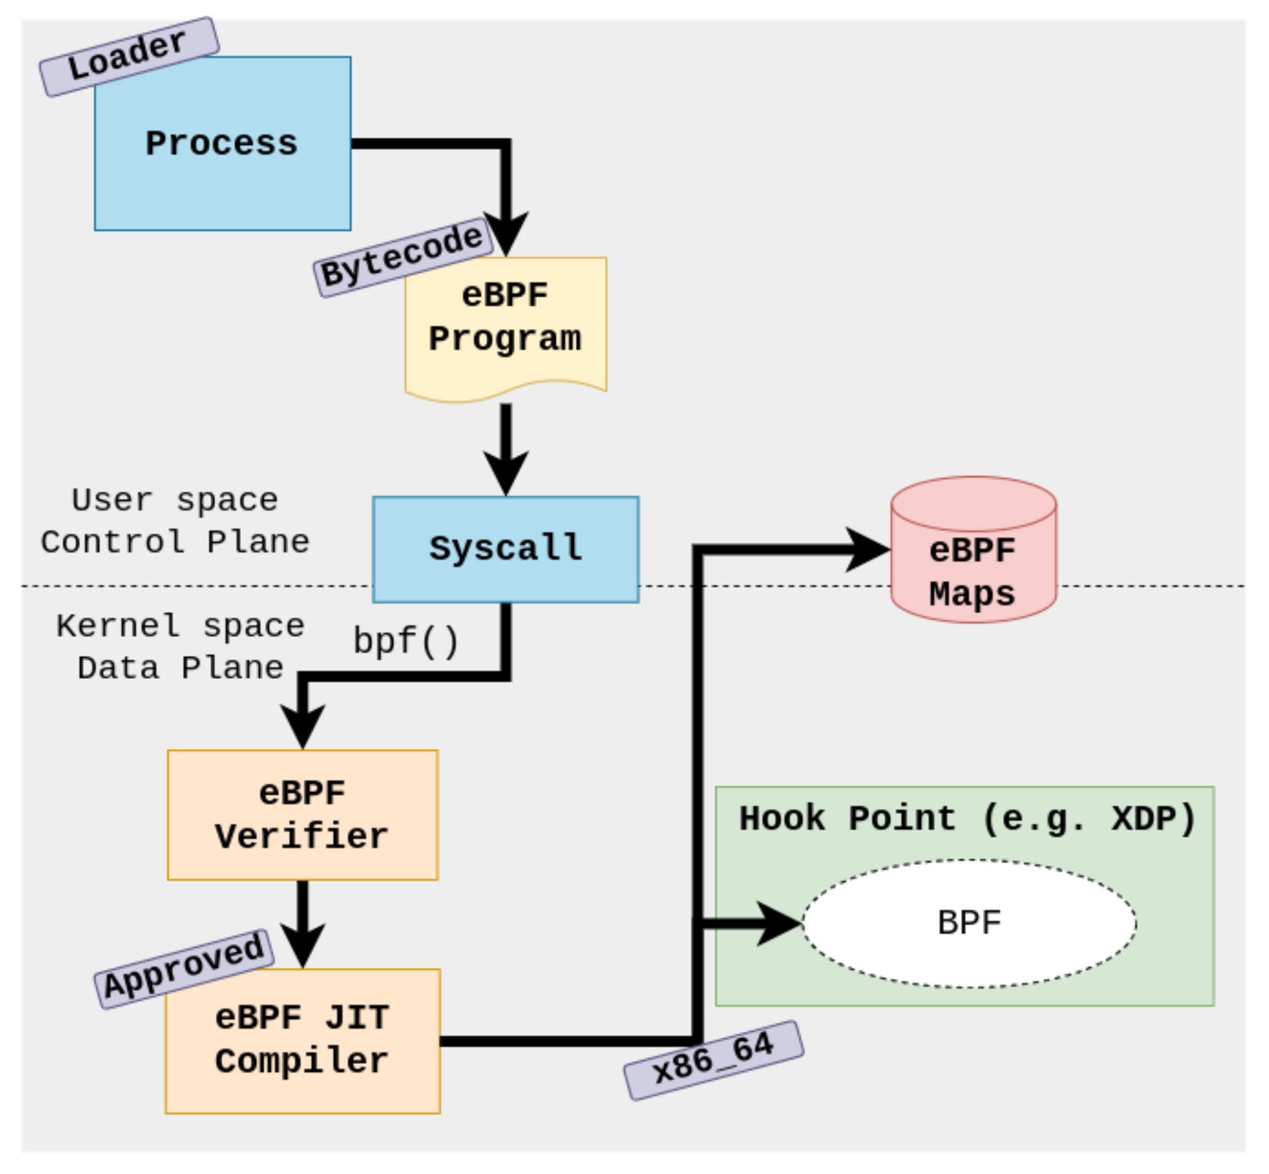
Life of an eBPF program
You compile a source code to BPF byte-code (BPF is ran in a dedicated Virtual-Machine, and has its own instruction set) using a suitable compiler (e.g. LLVM)
Your user mode program requests the kernel to store the compiled instructions, via the bpf(2) syscall with the BPF_PROG_LOAD command and a program type, which determines the type of our BPF module (e.g. BPF_PROG_TYPE_SOCKET_FILTER for packet filtering, BPF_PROG_TYPE_KPROBE for kernel probes)
The kernel will now run a static-analyser and verify the control-flow-graph of the code is safe for use (The BPF VM is quite strict, most I/O operations are forbidden, infinite loops are detected etc.)
If the static checks above pass, the bpf(2) syscall results in a file-descriptor, which the user-mode program may operate against.
In addition to the above, one may create and use a predefined set of BPF data-structures to communicate between BPF routines, and between your routine and user-mode program.
Lastly, we may operate against our BPF module; For example, we may attach a kernel probe to it, so our routine would be called before or after a specific syscall is called.
Notes:
https://www.oreilly.com/library/view/learning-ebpf/9781098135119/ch04.html
https://github.com/iovisor/bcc/blob/master/docs/reference_guide.md

Slide 15
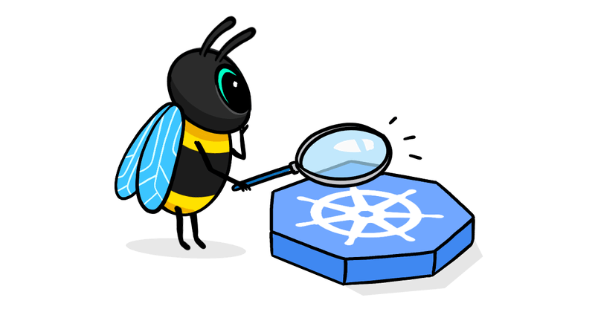
Using eBPF in Kubernetes

Slide 16
Applicatios of eBPF in Kubernetes
Performance monitoring
Cluster observability
Security monitoring
Filtering network traffic
Profiling and tracing

Slide 17
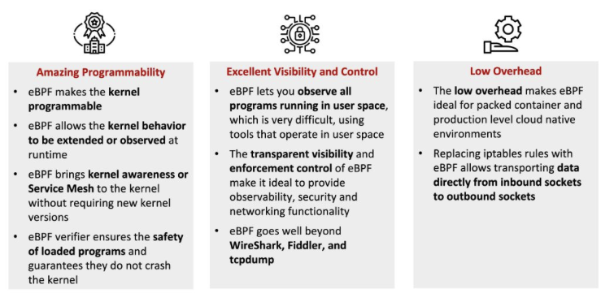
Why is eBPF lucrative for cloud-native apps
From a security perspective, eBPF allows for the creation of dynamic security policies in the kernel, providing fine-grained controls over process execution, system calls, and network access. This can enhance the security of Kubernetes by providing more granular control over these aspects.
eBPF can be a more efficient alternative to sidecar containers for certain use cases. Sidecar containers can add significant overhead, requiring running additional processes and often involving complex networking configurations.
eBPF programs run directly in the kernel, which can result in lower latency and higher performance. eBPF programs are isolated and secured through the kernel’s built-in mechanisms, reducing the potential attack surface.
Notes:
https://cybersecurity-magazine.com/the-power-of-ebpf-for-cloud-native-systems/#:~:text=eBPF%20enables%20programs%20to%20run,workload%20disruption%20and%20node%20reboot.

Slide 18
Kubernetes Networking
Feature | Without eBPF | With eBPF
Packet filtering | Rely on CNI plugins (like Calico, flannel) that are usually based off iptables– these can add latency and complexity in large clusters | Do away with iptables – use eBPF maps for faster lookups
Load balancing | Use kube-proxy for load-balancing, which internally uses iptables or ipvs | eBPF-based kube-proxy implements load balancing directly in the kernel, avoiding iptables traversal and latency.
Observability | Observability tools like tcpdump, or iptables logs that require capture at the userspace level - more sidecars, more overhead | Capture and analyze packets directly in the kernel
Pod-to-Pod communication | IP-in-IP, VXLAN | Forwarding/routing decisions can be taken early on, with XDP. Load balancing can also be handled by ebpf.
Notes:
IP-in-IP tunneling: Encapsulate one IP packet within another. Source and dest IPs are set to nodes’ IPs. The packet is routed based on the outer IP header; outer layer stripped when the original packet is delivered. Decapsulate at the destination pod. Calico uses this
VXLAN: The original ethernet frame is encapsulated in a vxlan header and an outer IP and udp header. The vxlan header includes a vxlan network ID (like VLAN ID) . The packet is routed across the network based on outer IP header. Destination is the IP address of the node. Decapsulate at the destination pod. Overlay networks like this allow pod networks to extend over layer 3 without changing below configs. Flannel uses this. Extra packet size due to added vlan header (50 bytes)
https://learnk8s.io/kubernetes-network-packets

Slide 19
Kubernetes Security
Feature | Without eBPF | With eBPF
Network Policies | Using iptables | Faster packet filtering, enforcement of network policies at the kernel
Runtime Security | Tools like Falco hook into system calls using kernel modules | eBPF can hook into kernel syscalls with minimal overhead (can track file access, process creation etc.)
Service-to-Service encryption | Service meshes use sidecar proxies to handle mTLS encryption | Enable encryption at the kernel level – no need for sidecars
Access Control | RBAC, admission control | Custom access controls at the kernel
Notes:
Seccomp (secure computing mode) - Seccomp stands for secure computing mode and has been a feature of the Linux kernel since version 2.6.12. It can be used to sandbox the privileges of a process, restricting the calls it is able to make from userspace into the kernel. Kubernetes lets you automatically apply seccomp profiles loaded onto a node to your Pods and containers. Restrict the set of syscalls a process can make. For ex. Runtime default profile allows most common syscalls but blocks calls like kexec_load, reboot etc. apiVersion: v1 kind: Pod metadata: name: default-pod labels: app: default-pod spec: securityContext: seccompProfile: type: RuntimeDefault containers: - name: test-container image: hashicorp/http-echo:1.0 args: - "-text=just made some more syscalls!" securityContext: allowPrivilegeEscalation: false
SELinux - SELinux is a mandatory access control mechanism, a higher level of access control than Linux's discretionary access control. SELinux acts under the least-privilege model. SELinux only grants access if the administrator writes a specific policy to do so.

Slide 20
Kubernetes Observability
Feature | Without eBPF | With eBPF
Metrics collection | Tools like Prometheus scrape metrics from applications, collecting system–level metrics requires additional agents | Application and system-level metrics can be collected directly at the kernel
Tracing | Service mesh sidecars | Tracing at the kernel level
Logging | Logging agents like Fluentd and Logstash can be used | eBPF apps can hook into app logs directly in the kernel
Latency | TCP retranmission, RTT are used for monitoring | Enable tracking latency at the kernel syscall/scheduling granularity

Slide 21

Lab - 1
- Setup Kubernetes cluster - Setup the base eBPF container
Notes:
https://github.com/iovisor/bcc/blob/master/docs/reference_guide.md#5-get_syscall_fnname

Slide 22
Do all kernels let you run eBPF?
Kernel headers specific to the version
Kernel compile flags (/boot/config-$(uname –r))
CONFIG_BPF (bpf vm interpreter)
CONFIG_BPF_SYSCALL (enable the bpf syscall)
Privileged mode execution
Notes:
https://github.com/iovisor/bcc/blob/master/docs/kernel_config.md

Slide 23
Lab-2: Tracing execve() syscall
Sample program to attach a BPF function to exece syscall and track how many syscalls each user makes.
Run the helloworld program and see the following:
bpftool prog show name <>
Xlated: size after translation; adjusted for kernel verifier
Jited: size when ELF was generated
Tag: Program label
loaded_at: Timestamp of prog load
btf_id: BTF (BPF Type Format) is the metadata format which encodes the debug info related to BPF program/map. The name BTF was used initially to describe data types. The BTF was later extended to include function info for defined subroutines, and line info for source/line information.
Deploy the helloworld pod into the Kubernetes cluster and view the pod logs.
Notes:
strace -e bpf ./hello-buffer-config.py

Slide 24
Utilities to analyze BPF objects
Utility to inspect and manage BPF objects on the system.
sudo bpftool prog list
sudo bpftool prog show
sudo bpftool map dump name <>
sudo bpftool map show name <>
sudo bpftool btf show id <>
Strace –e bpf <py-file>
Intercept and record the system calls which are called by the process and the signals received by the process
https://github.com/iovisor/bcc/blob/master/docs/reference_guide.md

Slide 25
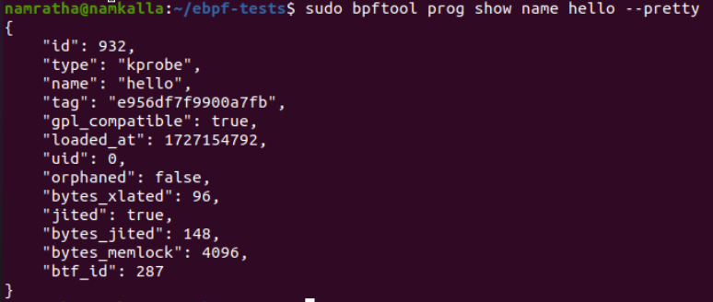
Example bpftool output
ID: eBPF program ID
Bytes_xlated: Translated eBPF bytecode
Bytes_jited: JIT compiled and resulted in 148 bytes
Bytes_memlock: 4096 bytes of memory reserved that won’t be paged out
Btf_id:

Slide 26
Lab-3: Setup additional pods
Deploy frontend, Backend and Database pods for the labs to follow

Slide 27

Lab Agenda
Packet filtering
DDoS attack detection
Logging/Tracing flows
Understanding BPF hooks
Notes:
Agenda: Kubernetes networking, security and observability

Slide 28
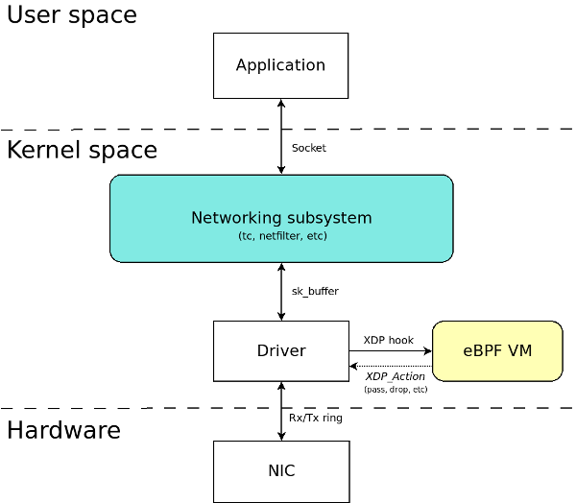
XDP – Express Data path
eXpress Data Path (XDP) is a framework that makes it possible to perform high-speed packet processing within BPF applications. To enable faster response to network operations, XDP runs a BPF program as soon as possible, usually immediately as a packet is received by the network interface.
Here are some of the operations an XDP program can perform with the packets it receives, once it is connected to a network interface:
XDP_DROP – Drops and does not process the packet. eBPF programs can analyze traffic patterns and use filters to update the XDP application in real time to drop specific types of packets (for example, malicious traffic).
XDP_PASS – Indicates that the packet should be forwarded to the normal network stack for further processing. The XDP program can modify the content of the package before this happens.
XDP_TX – Forwards the packet (which may have been modified) to the same network interface that received it.
XDP_REDIRECT – Bypasses the normal network stack and redirects the packet via another NIC to the network.
Notes:
https://www.datadoghq.com/blog/xdp-intro/

Slide 29
Lab 4: Filter packets using eBPF
Use XDP to filter out UDP/ICMP packets in the kernel.
This could be deployed as a pod on the cluster or deployed on the host.

Slide 30
Lab 5: DDoS attack detection
Detect DDoS attack using eBPF. Attach hooks to tap every packet received on a particular port.
Notes:
Refer: https://www.loft.sh/blog/tutorial-how-ebpf-improves-observability-within-kubernetes

Slide 31
Lab 6: Tracing network flows
Trace all pod traffic at an IP level using eBPF.
Notes:
https://medium.com/@isalapiyarisi/getting-started-on-kubernetes-observability-with-ebpf-88139eb13fb2

Slide 32
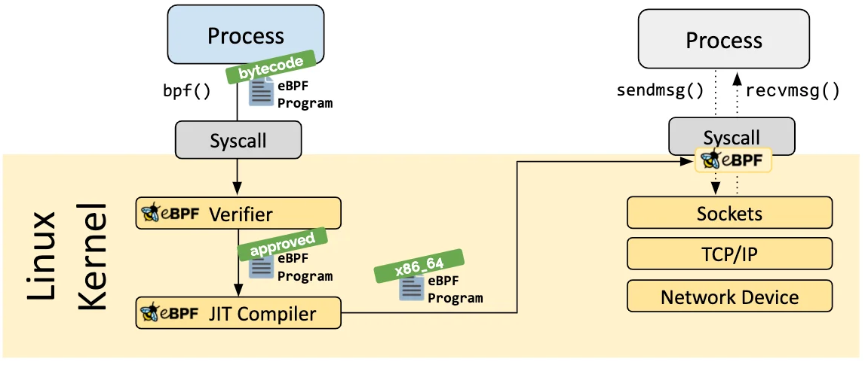
eBPF Verifier
If a process is allowed to load an eBPF program, all programs still pass through the eBPF verifier. The eBPF verifier ensures the safety of the program itself. This means, for example:
Programs are validated to ensure they always run to completion, e.g., an eBPF program may never block or sit in a loop forever. eBPF programs may contain bounded loops but the program is only accepted if the verifier can ensure that the loop contains an exit condition which is guaranteed to become true.
Programs may not use any uninitialized variables or access memory out of bounds.
Programs must fit within the size requirements of the system. It is not possible to load arbitrarily large eBPF programs.
Notes:
Verifier does not check what the program is doing. It is to be used only for ensuring if the program is safe to execute.

Slide 33
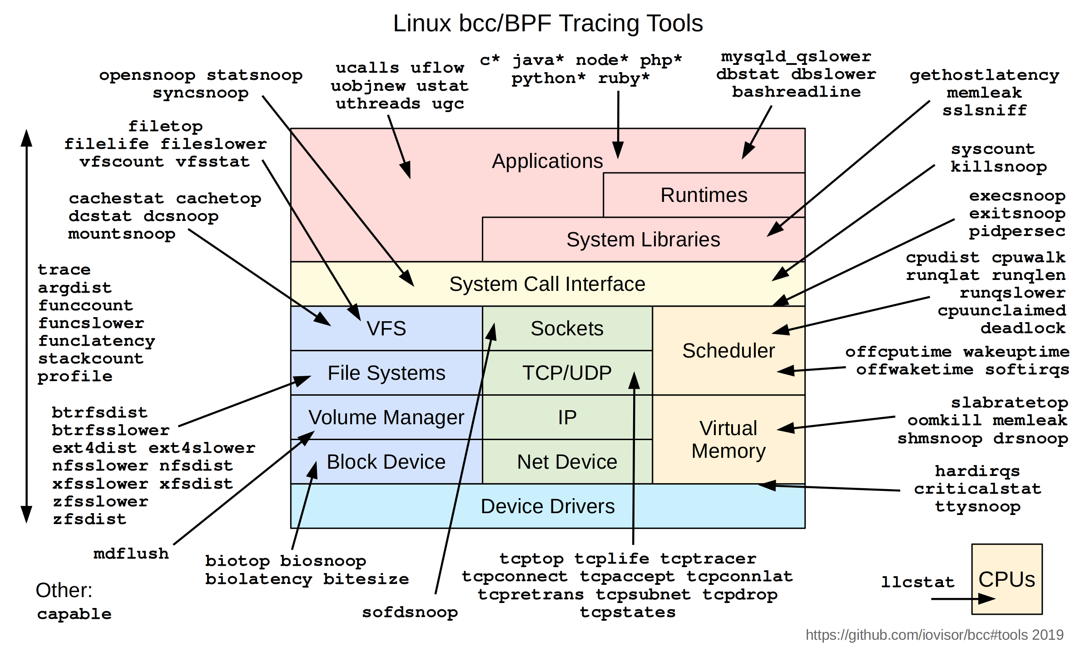
BCC tools
Examples
execsnoop: Trace all exec() calls
exitsnoop: Trace all process exit() calls.
runqlat: Find the time spent by processes in the run queue.
opensnoop: Trace all open() calls
wakeuptime: Trace the waker thread and all threads woken by the parent process
Notes:
Bcc/tools

Slide 34
Lab-7: BCC Tools - runqlat - cpudist - sslsniff
Runqlat: Find per process/namespace or an overall summary of how long processes spend in the run queue.
Cpudist: Find the on-cpu time per process/namespace or an overall summary
Sslsniff: Trace every ssl_read()/ssl_write() call by attaching uprobe() at the user space calls.
Other popular use-cases:
Load balancing
Notes:
https://bristot.me/efficient-formal-verification-for-the-linux-kernel/
https://github.com/torvalds/linux/blob/850925a8133c73c4a2453c360b2c3beb3bab67c9/kernel/sched/core.c#L4804
ttwu_do_wakeup(): mark the task runnable
wake_up_new_task - wake up a newly created task for the first time.
This function will do some initial scheduler statistics housekeeping that must be done for every newly created context, then puts the task on the runqueue and wakes it.
finish_task_switch - clean up after a task-switch
@prev: the thread we just switched away from.
If you want to trace out this data in its unencrypted form, eBPF allows us to attach custom programs just before data is encrypted and sent, and after it is received and decrypted.
SSL_write(): function used in the OpenSSL library to write data to an SSL/TLS connection. We primarily utilize it to intercept the data written by the client — not yet encrypted.
SSL_read(): function used in the OpenSSL library to read data from an SSL/TLS connection. It allows us to intercept the decrypted data received by the server as well as parsing the return code e.g. HTTP status code like 200 (Successful GET request).

Slide 35
eBPF hooks
Sockets - BPF_PROG_TYPE_SOCKET_FILTER for socket data filtering; intercept sock ops, BPF_PROG_TYPE_SK_SKB for sockmap ops, redirecting traffic based to different destinations
Traffic control - The Traffic Control (TC) subsystem empowers users with a high degree of control and configurability over the handling of network packets. This includes managing parameters such as packet rates, network latency, packet integrity, and more.
Lightweight Tunnels: The family of BPF_PROG_TYPE_LWT_* program types allows the implementation of network encapsulation in eBPF programs
Cgroups - there are socket-related program types specific to cgroups BPF_PROG_TYPE_CGROUP_SOCK and BPF_PROG_TYPE_CGROUP_SKB. eBPF programs can determine whether a given cgroup is permitted to perform a requested socket operation or data transmission. This is useful for network security policy enforcement.
XDP – express data path; perform high speed packet processing within the kernel
Notes:
https://github.com/iovisor/bcc/blob/master/docs/reference_guide.md
https://docs.redhat.com/en/documentation/red_hat_enterprise_linux/8/html/configuring_and_managing_networking/linux-traffic-control_configuring-and-managing-networking#inspecting-qdisc-of-a-network-interface-using-the-tc-utility_linux-traffic-control
The Linux Traffic Control (TC) subsystem helps in policing, classifying, shaping, and scheduling network traffic. TC also mangles the packet content during classification by using filters and actions. The TC subsystem achieves this by using queuing disciplines (qdisc)

Slide 36
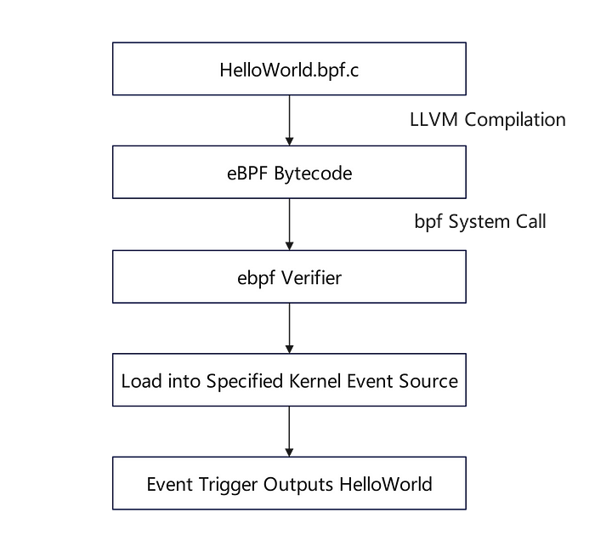
Libbpf v/s bcc for development
Libbpf does not use python. The C programs need to be compiled with clang and loaded using the bpftool
#include <linux/bpf.h> #include <bpf/bpf_helpers.h> int helloworld(void *ctx) { bpf_printk("Hello world!\n"); return 0; }
Compile using:
clang -target bpf -Wall -O2 -g -c HelloWorld.bpf.c -o HelloWorld.o
Attach program using:
bpftool prog load HelloWorld.o /sys/fs/bpf/HelloWorld type raw_tracepoint
Notes:
https://medium.com/@matrixorigin-database/bpf-development-starting-with-hello-world-c309941d6b3f
https://facebookmicrosites.github.io/bpf/blog/2020/02/20/bcc-to-libbpf-howto-guide.html

Slide 37


Slide 38
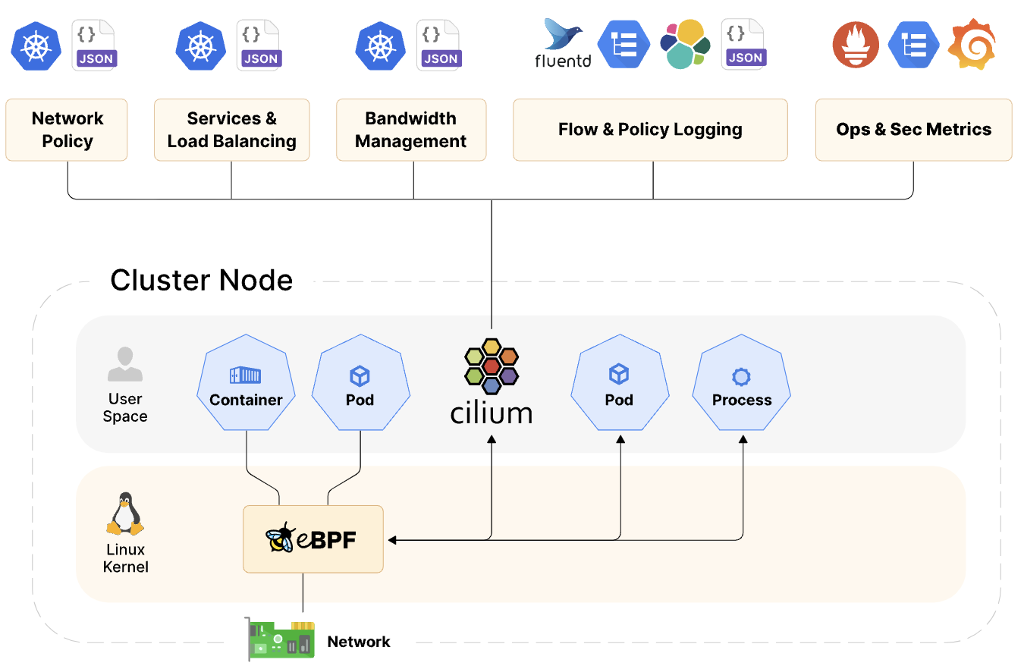
Overview of Cilium
Cilium (by Isovalent) is an open source, cloud native solution for providing, securing, and observing network connectivity between workloads, using eBPF at its core. It's popular for container management platforms like Kubernetes.
Notes:
CNI consists of a specification and libraries for writing plugins to configure network interfaces in Linux containers, along with a number of supported plugins. CNI concerns itself only with network connectivity of containers and removing allocated resources when the container is deleted.
https://isovalent.com/product/
Cilium is adopted by companies like Bell Canada, Google, The NYT

Slide 39
Overview of Cilium
Cilium comprises four key components: the Cilium agent, the Cilium client command line tool, the Cilium operator, and the Cilium CNI plugin.
The agent, running on all cluster nodes, configures networking, load balancing, policies, and monitoring via Kubernetes or APIs that describe networking, service load-balancing, network policies, and visibility & monitoring requirements.
The client tool, bundled with the agent, inspects and manages the local agent's status, offering direct access to eBPF maps.
The operator centrally manages cluster tasks, handling them collectively rather than per node.
The CNI plugin, invoked by Kubernetes during pod scheduling or termination, interacts with the node's Cilium API to configure necessary datapaths for networking, load balancing, and network policies.

Slide 40
Why use Cilium?

Slide 41
Packet routing in traditional container environments

Slide 42
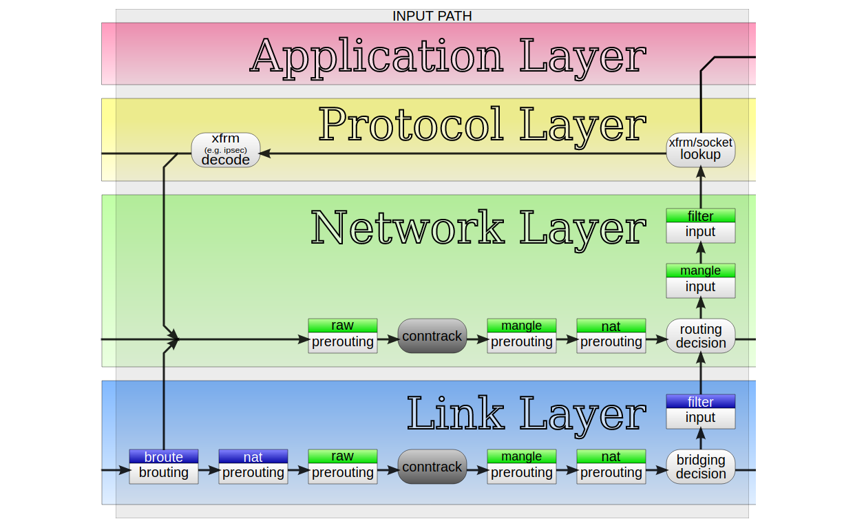
Linux conntrack and packet mangling
"Conntrack" is a part of Linux network stack, specifically part of the firewall subsystem. Early firewalls were entirely stateless. They could express only basic logic, like, allow SYN packets to port 80 and 443, and block everything else.
The stateless design gave some basic network security but is insufficient. There are certain things that can't be expressed in a stateless way. The canonical example is assessment of ACK packets - it's impossible to say if an ACK packet is legitimate or part of a port scanning attempt, without tracking the connection state.
To fill such gaps all the operating systems implemented connection tracking inside their firewalls. This tracking is usually implemented as a big table, with at least 6 columns: protocol (usually TCP or UDP), source IP, source port, destination IP, destination port and connection state. On Linux this subsystem is called "conntrack" and is often enabled by default.
Sudo conntrack –L
Mangle is a marker that marks a packet for future processing. For instance, you could alter the TTL on the packet or the source IP (as in NAT)
Notes:
Protect local applications from receiving unwanted network traffic (INPUT chain)
Protect local applications sending undesired network traffic (OUTPUT chain)
Filter network traffic forwarded/routed by a Linux system (FORWARD chain).

Slide 43
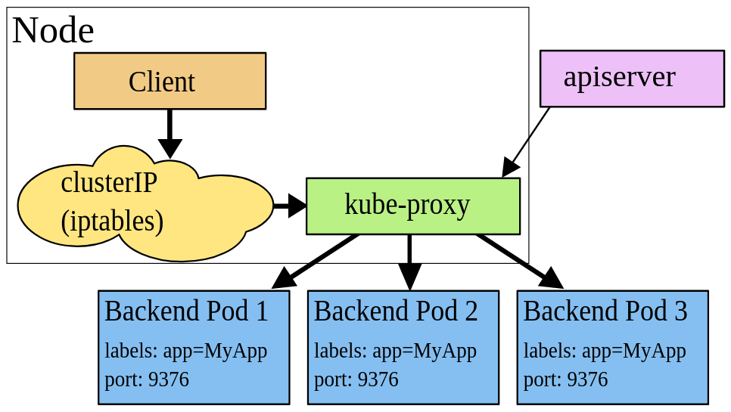
Kube-proxy in kubernetes
Kube-proxy is installed on each node and ensures network traffic flows from services to the appropriate pods. When a new service or endpoint is created, it abstracts the underlying pod IPs, allowing other services to communicate with it using the service’s virtual IP address.
kube-proxy acts as a network proxy. It manages network rules necessary for routing traffic, including Network Address Translation (NAT) when required, to ensure packets reach their intended destinations. For services with multiple pods for high availability or scalability, kube-proxy acts as the load balancer. It distributes incoming traffic among the pods to ensure balanced workloads and efficient resource utilization.
Iptables was built as a packet filter and firewall tool within the Linux kernel. It analyses, modifies, and filters network packets on a set of user-defined rules based on IP addresses or port-based rules (TCP/UDP).
Iptables rules are organized into iptables tables and iptables chains. An iptables chain is the ordered list of rules that is evaluated sequentially when a packet traverses the chain. An iptables table is a way to group together chains of rules, iptables has five tables covering Filter, NAT, Mangle, Raw, and Security.
Kube-proxy has 4 modes of execution:
Iptables: configure packet forwarding rules using iptables
Ipvs: redirect traffic using ip virtual server(ipvs) and iptables apis.
Kernelspace: program rules in windows kernel (specific to windows OS only)
Nftables: alternative to iptables, more convenient to use like using lookup tables instead of linear chain processing
Notes:
Consider iptables as a set of kernel modules to filter or mangle packets.
iptables has been the primary tool to implement firewalls and packet filters on Linux
Protect local applications from receiving unwanted network traffic (INPUT chain)
Protect local applications sending undesired network traffic (OUTPUT chain)
Filter network traffic forwarded/routed by a Linux system (FORWARD chain).
sudo iptables –L
Protect local applications from receiving unwanted network traffic (INPUT chain)
Protect local applications sending undesired network traffic (OUTPUT chain)
Filter network traffic forwarded/routed by a Linux system (FORWARD chain).
https://cilium.io/blog/2018/04/17/why-is-the-kernel-community-replacing-iptables/
https://www.youtube.com/watch?v=0Omvgd7Hg1I

Slide 44
Packet routing in container environments with Cilium

Slide 45
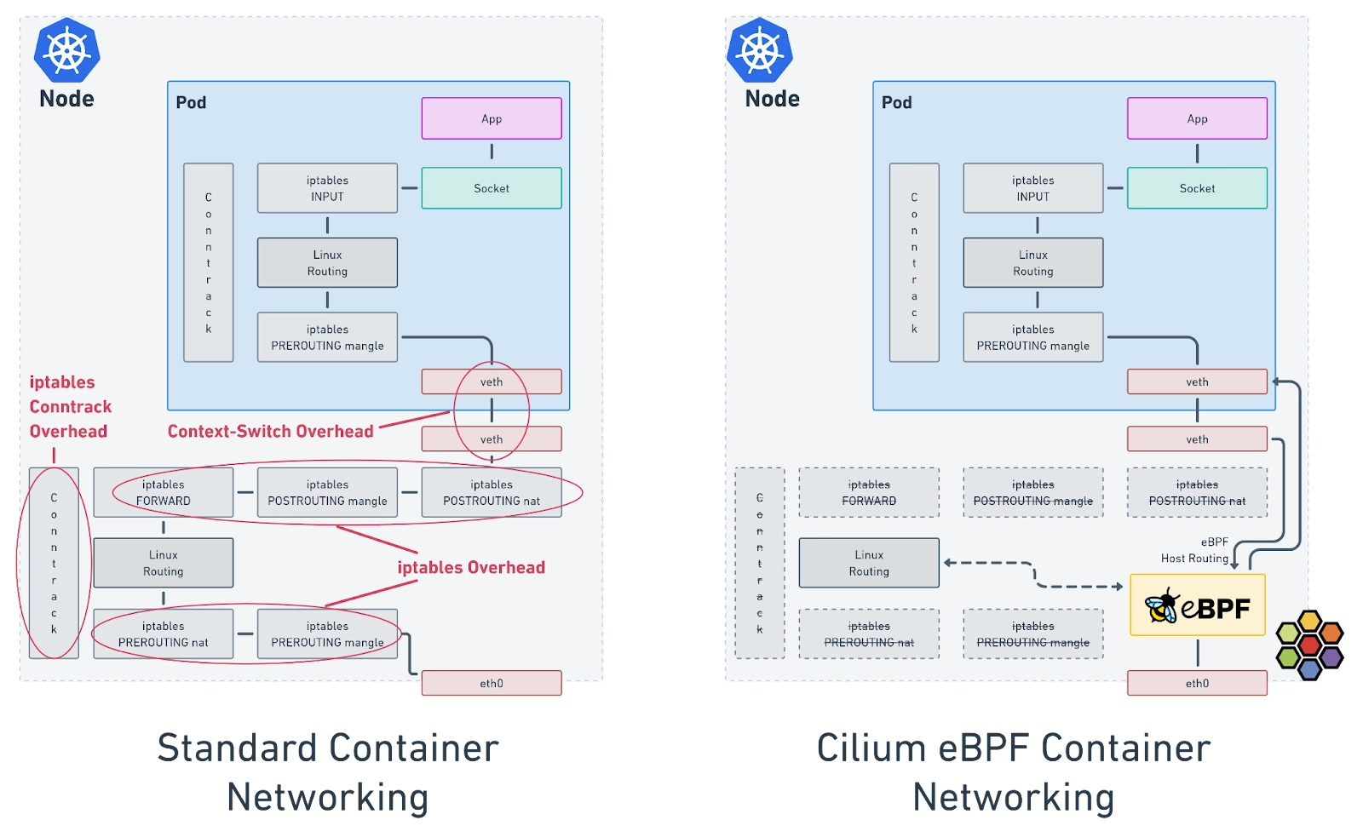
Replace iptables and kube-proxy with eBPF
The Cilium dataplane offers a replacement of kube-proxy, making it easy to transition from iptables to eBPF programs. Cilium installs eBPF and XDP (eXpress Data Path) programs on each Kubernetes node, bypassing the overhead from iptables. This approach minimizes overhead and context-switching requirements, allowing for efficient packet processing that leads to the lower latency and CPU overhead.
Notes:
eBPF hash maps are used for storing firewall info. So, lookups are faster.
https://cilium.io/blog/2018/04/17/why-is-the-kernel-community-replacing-iptables/
Pods are also identity-based, so no hassle of rewriting iptables every time a pod dies and comes back.

Slide 46
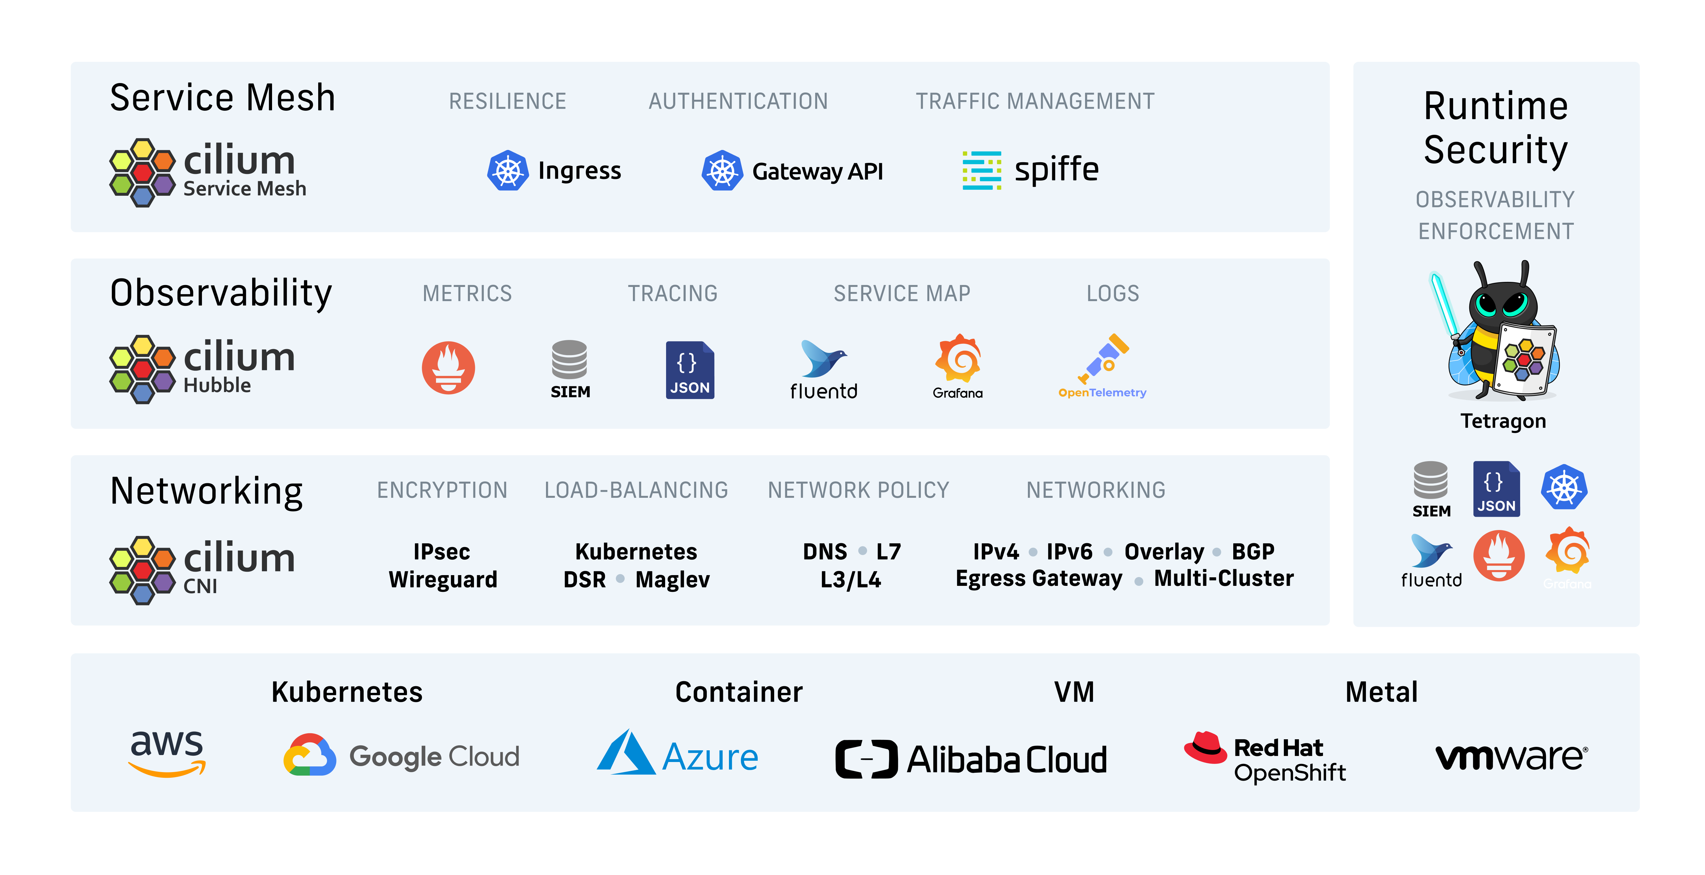
Use cases of Cilium
Notes:
https://isovalent.com/blog/post/top-20-cilium-use-cases/
Envoy is used as the proxy

Slide 47
Cilium Projects
Networking and Security: Cilium
Security visibility and enforcement: Tetragon
Ops and Observability: Hubble
Notes:
Security profiles like seccomp can be applied with Tetragon
Monitoring linux kernel modules that maybe loaded at runtime
process privileges
File access tracing

Slide 48
Lab-8
Enable cilium in your Kubernetes cluster

Slide 49
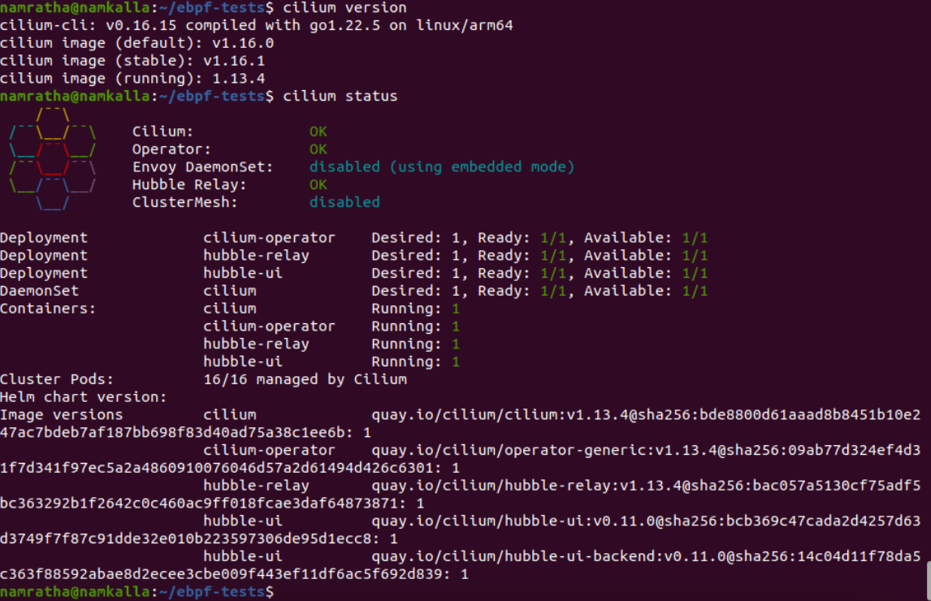
Check cilium status and version

Slide 50
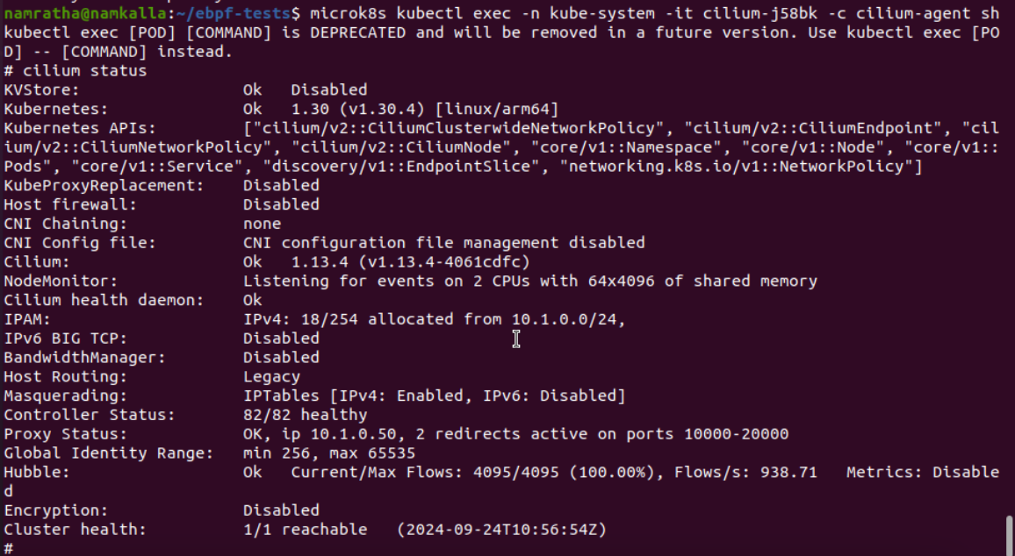
Check if eBPF-based host routing is enabled on your cluster
Host Routing is set to Legacy on my cluster. It Is still using iptables.
Notes:
https://docs.cilium.io/en/latest/operations/performance/tuning/#ebpf-host-routing

Slide 51
Cilium Hooks: Where can you expect to find a cilium program attached?
XDP
Traffic Control (Ingress/Egress): BPF programs attached to the traffic control (tc) ingress hook are attached to a networking interface, same as XDP, but will run after the networking stack has done initial processing of the packet. The hook is run before the L3 layer of the stack but has access to most of the metadata associated with a packet. This is ideal for doing local node processing, such as applying L3/L4 endpoint policy and redirecting traffic to endpoints.
Socket Operations (BPF socket program that is attached to root cgroup and uses it to monitor TCP socket state transitions). When a socket transitions into ESTABLISHED state if the TCP socket has a node local peer (possibly a local proxy) a socket send/recv program is attached.
Socket send/recv: The socket send/recv hook runs on every send operation performed by a TCP socket. At this point the hook can inspect the message and either drop the message, send the message to the TCP layer, or redirect the message to another socket.
Notes:
https://docs.cilium.io/en/stable/network/ebpf/intro/ Containers typically use a virtual device called a veth pair which acts as a virtual wire connecting the container to the host. By attaching to the TC ingress hook of the host side of this veth pair Cilium can monitor and enforce policy on all traffic exiting a container. By attaching a BPF program to the veth pair associated with each container and routing all network traffic to the host side virtual devices with another BPF program attached to the tc ingress hook as well Cilium can monitor and enforce policy on all traffic entering or exiting the node.

Slide 52
View cilium objects with bpftool utility
To view the bpf programs attached to each attachment point
sudo bpftool net list
sudo bpftool net show dev <> (E.g., Cilium_vxlan, cilium_net, cilium_host)
To view bpf maps created by Cilium
sudo bpftool map (look for maps with prefix cilium)
sudo bpftool map dump name <map-name>

Slide 53
Cilum custom resource definition
CiliumNetworkPolicy: like Kubernetes network policy
CiliumClusterwideNetworkPolicy
CiliumIdentity:
Kubectl get ciliumidentity --all-namespaces –o json
CiliumEndpoint: One CiliumEndpoint resource is created for each pod managed by cilium.
kubectl get ciliumendpoints –all-namespaces –o json
Notes:
Cilium Identity: Every time a new pod with the label role=frontend or role=backend is either started or stopped, the rules on every cluster node which run any such pods must be updated by either adding or removing the corresponding IP address from the list of allowed IP addresses. In large distributed applications, this could imply updating thousands of cluster nodes multiple times per second depending on the churn rate of deployed pods. Cilium entirely separates security from network addressing. Instead, security is based on the identity of a pod, which is derived through labels. This identity can be shared between pods. This means that when the first role=frontend pod is started, Cilium assigns an identity to that pod which is then allowed to initiate connections to the identity of the role=backend pod. The subsequent start of additional role=frontend pods only requires to resolve this identity via a key-value store, no action has to be performed on any of the cluster nodes hosting role=backend pods. Cilium Endpoint: All application containers which share a common address are grouped together in what Cilium refers to as an endpoint.
https://docs.cilium.io/en/latest/gettingstarted/terminology

Slide 54
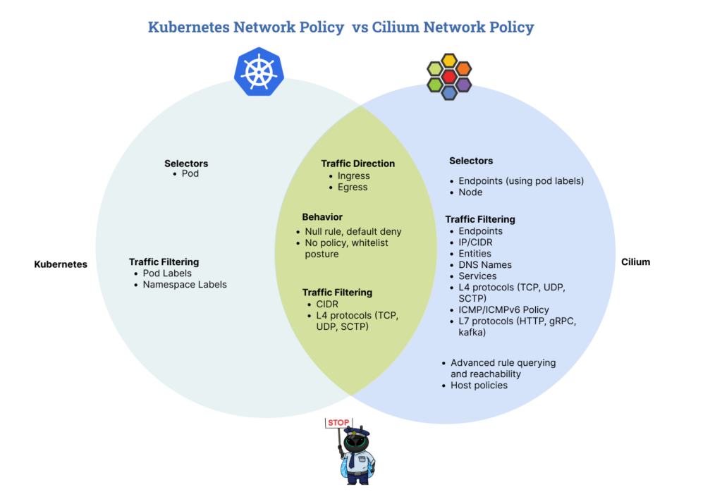
Kubernetes NetworkPolicy vs Cilium Network Policy
Notes:
https://isovalent.com/blog/post/intro-to-cilium-network-policies/
With Cilium network policies, we can implement fine-grained rules at Layers 3, 4, and 7 of the OSI model, catering to broader and more relevant use cases than the standard Kubernetes network policy.
Cilium introduces two new Kubernetes custom resource definitions(CRDs): CiliumNetworkPolicy and CiliumClusterwideNetworkPolicy. With these CRDs, we can define security policies with Cilium as Kubernetes objects, and Kubernetes automatically distributes these policies to all the nodes in the cluster. The CiliumNetworkPolicy CRD is namespaced scoped, while the CiliumClusterwideNetworkPolicy CRD works similarly to the CiliumNetworkPolicy but is cluster-scoped.
At Layer 3, Cilium’s endpoint-based policies can define connectivity rules based on pod labels. Service-based policies use orchestration systems services like Kubernetes service endpoints to define connectivity rules. Entity-based policies allow categorizing remote peers without knowing their IP addresses. IP/CIDR-based policies define connectivity rules for external services using hardcoded IP addresses or subnets. DNS-based policies can define connectivity rules based on DNS names resolved to IP addresses.
At Layer 4, Cilium network policies can define rules that allow an endpoint to emit and receive packets on a specific port using a specific protocol. Finally, at Layer 7, Cilium network policies allow defining rules for API-level security for common Layer 7 protocols such as HTTP, Kafka, gRPC, etc.

Slide 55
Lab-9: Cilium Network Policy demo
Use CIliumNetworkPolicy to disable all communication to database pod, except from the backend pod
Notes:
https://medium.com/@charled.breteche/kubernetes-security-explore-cilium-host-firewall-and-host-policies-de93ea9da38c
https://isovalent.com/blog/post/intro-to-cilium-network-policies/
The CiliumNetworkPolicy custom resource definition (CRD) can be broken down into three parts: the endpoint selector, ingress, and egress policies. The endpoints selector field selects endpoints based on the pod labels and specifies which pod(s) a policy should be applied to. With the CiliumClusterWideNetworkPolicy resource, we replace the endpoint selector field with the node selector field, and the node labels are used to specify which node a policy applies to. The ingress and egress section allows us to define ingress and egress traffic rulesets respectively.

Slide 56
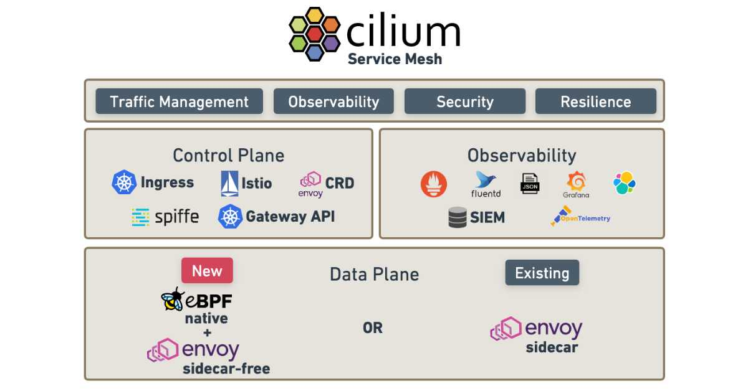
Cilium Service Mesh
Cilium Service Mesh redefines traditional service mesh frameworks by integrating the mesh layer directly into the kernel using eBPF, thus eliminating the need for sidecar proxies.
https://isovalent.com/

Slide 57
Isovalent Labs
https://isovalent.com/resource-library/labs/

Slide 58
Real-world use cases of eBPF
Netflix
Google
Notes:
https://netflixtechblog.com/how-netflix-uses-ebpf-flow-logs-at-scale-for-network-insight-e3ea997dca96
https://blog.cloudflare.com/live-patch-security-vulnerabilities-with-ebpf-lsm/
https://ebpfchirp.substack.com/p/securing-kubernetes-workloads-using?utm_medium=email&_hsenc=p2ANqtz-_ub4WpjHLvrK4VtjlLwqOgY-7_gI3-sZqP9tegVadbPCy30Aa-klWWXbRGxxQvUrp_nNL_KZ9UVZ866DSarlVntO9jBw&_hsmi=328130917&utm_content=328130917&utm_source=hs_email

Slide 59
Cons of using eBPF
Dependence on kernel headers – need to be CO-RE compliant
Program that runs on one kernel may be rejected by another kernel.
Still a nascent solution for Windows workloads.
Notes:
https://www.alibabacloud.com/blog/the-advantages-and-disadvantages-of-ebpf_599975
https://www.groundcover.com/ebpf#:~:text=And%20because%20verification%20doesn't,more%20difficult%20and%20less%20intuitive.
https://opensource.microsoft.com/blog/2021/05/10/making-ebpf-work-on-windows/

Slide 60
References
eCHO newsletter
Isovalent blogs
https://github.com/isala404/kube-ebpf

Slide 61
Backup slides

Slide 62
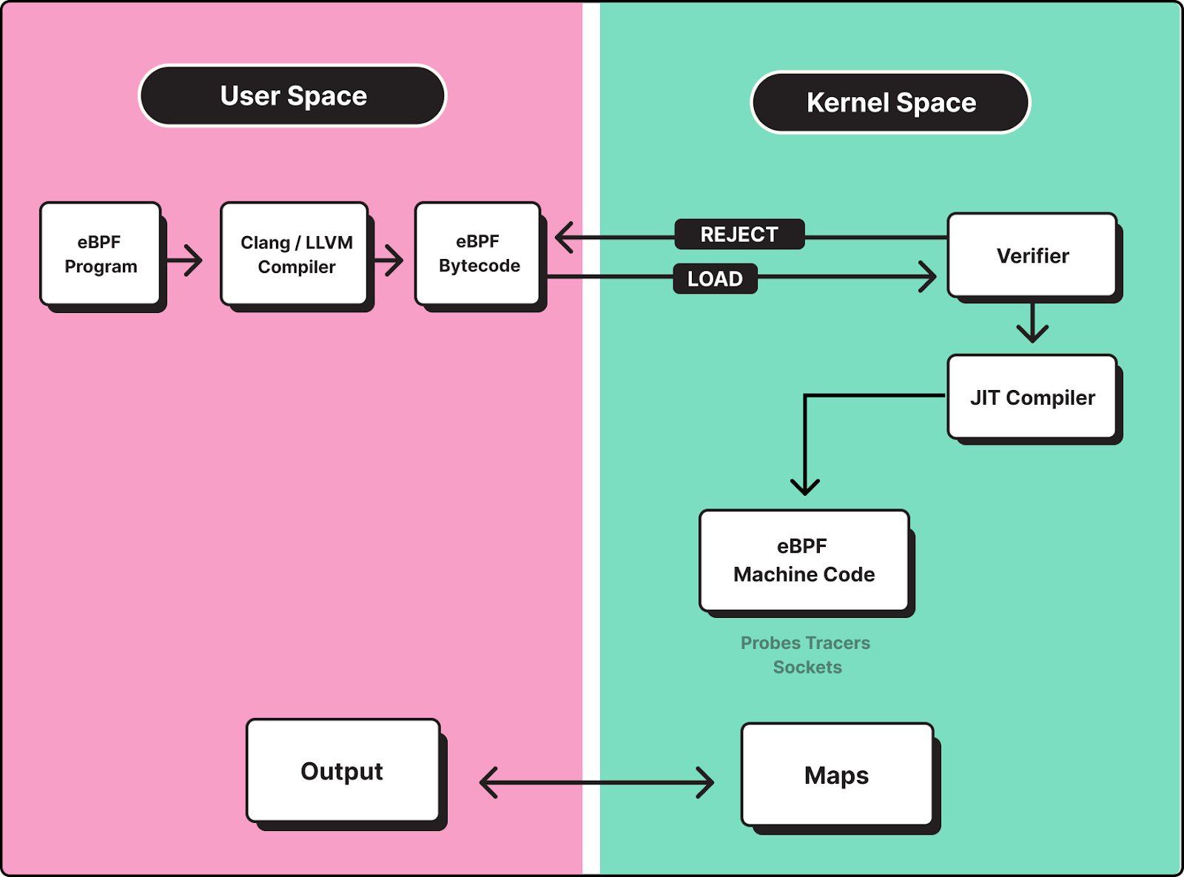
How does eBPF work?

Slide 63
Systemd, systemctl, cgroup commands
sudo system-cgls
Get into a specific container of a pod and find it’s cgroup details
Kubectl exec –it <podname> -c <container-name-in-pod> sh
Then read: /proc/self/cgroup
Notes:
Pod resource limits:
Guaranteed
Burstable
BestEffort

Slide 64
/pause container in kubernetes
The “pause container” is a special, internal container created and managed by Kubernetes within each pod. Its primary purpose is to serve as a placeholder for the network namespace and IPC (Inter-Process Communication) namespace for all other containers within the same pod. It is a critical component of Kubernetes’ container orchestration mechanism, providing the foundation for container-to-container communication and network isolation within a pod.
The pause container is a special type of container that is used to create a network namespace for each Pod in Kubernetes. It is responsible for routing traffic between the Pod and the outside world.
The pause container is automatically created by containerd when you start a Pod. It is not visible to kubectl, but you can see it using the ctr command. For example, the following command will list all pause containers on the node:
The pause container shares its network namespace with all other containers in the pod. This means that all containers in the pod can communicate with each other over the same network stack, including sharing the same IP address and port space. This enables containers within the same pod to easily communicate with each other as if they were running on the same host.
IPC Namespace: Similar to the network namespace, the pause container also shares its IPC namespace with other containers in the pod. This allows containers within the pod to use inter-process communication mechanisms like System V IPC and POSIX message queues to communicate with each other.
Lifetime Management: The pause container is responsible for managing the lifecycle of the pod. When all other containers within the pod have completed their tasks and exited, the pause container remains running, effectively keeping the pod alive. This ensures that the resources allocated to the pod, such as network namespaces, are not prematurely released.
Minimal Resource Usage: The pause container is typically minimal in terms of resource usage. It usually doesn’t run any application code or perform any specific functions other than serving as a placeholder for namespaces. Because of its minimal nature, it consumes very few system resources.
Automatically Managed: Kubernetes automatically creates and manages the pause container, and it is not directly visible or configurable by users or administrators. It is created when the pod is started and terminated when the pod is deleted.
Notes:
Pause container creates the network namespace in the pod

Slide 65
Components created by Cilium
Combining the hooks with virtual interfaces (cilium_host, cilium_net), an optional overlay interface (cilium_vxlan), Linux kernel crypto support and a userspace proxy (Envoy) Cilium creates the following networking objects.
Prefilter: The prefilter object runs an XDP program and provides a set of prefilter rules used to filter traffic from the network for best performance. Specifically, a set of CIDR maps supplied by the Cilium agent are used to do a lookup and the packet is either dropped or processed.
Endpoint Policy: The endpoint policy object implements the Cilium endpoint enforcement. Depending on the policy this layer may drop the packet, forward to a local endpoint, forward to the service object or forward to the L7 Policy object for further L7 rules. This is the primary object in the Cilium datapath responsible for mapping packets to identities and enforcing L3 and L4 policies.
Service: The Service object performs a map lookup on the destination IP and optionally destination port for every packet received by the object. If a matching entry is found, the packet will be forwarded to one of the configured L3/L4 endpoints. Can be used as a load-balancer too.
Socket Layer Enforcement: Socket layer enforcement uses two hooks (the socket operations hook and the socket send/recv hook) to monitor and attach to all TCP sockets associated with Cilium managed endpoints, including any L7 proxies. The socket operations hook will identify candidate sockets for accelerating. These include all local node connections (endpoint to endpoint) and any connection to a Cilium proxy.
L7 Policy: The L7 Policy object redirects proxy traffic to a Cilium userspace proxy instance. Cilium uses an Envoy instance as its userspace proxy. Envoy will then either forward the traffic or generate appropriate reject messages based on the configured L7 policy.
L3 Encryption: On ingress the L3 Encryption object marks packets for decryption, passes the packets to the Linux xfrm (transform) layer for decryption, and after the packet is decrypted, the object receives the packet then passes it up the stack for further processing by other objects.
Notes:
https://docs.cilium.io/en/stable/network/ebpf/intro/

Slide 66
CO-RE: Compile once, Run everywhere
BPF is heavily dependent on kernel headers and other structures, that may change between kernel versions.
BPF CO-RE brings together necessary pieces of functionality and data at all levels of the software stack: kernel, user-space BPF loader library (libbpf), and compiler (Clang) – to make it possible and easy to write BPF programs in a portable manner, handling discrepancies between different kernels within the same pre-compiled BPF program.
BTF is a space-efficient, compact, yet still expressive enough format to describe all the type information of C programs.
Clang was extended with few built-ins. They emit BTF relocations which capture a high-level description of what pieces of information BPF program code intended to read. You can find an element by name and type information (field offset relocation)
Libbpf (BPF loader) takes compiled BPF ELF object file, post-processes it as necessary, sets up various kernel objects (maps, programs, etc), and triggers BPF program loading and verification.
After libbpf processed BPF program code, to kernel it looks like any other valid BPF program code.
Notes:
How do you make sure you are not reading garbage data when some kernel added an extra field before the field you thought is, say, at offset 16 from the start of struct task_struct? Suddenly, for that kernel, you'll need to read data from, e.g., offset 24. And the problems don't end there: what if a field got renamed, as was the case with thread_struct's fs field (useful for accessing thread-local storage), which got renamed to fsbase between 4.6 and 4.7 kernels. Or what if you have to run on two different configurations of a kernel, one of which disabled some specific feature and completely compiled out parts of the struct (a common case for additional accounting fields, which are optional, but extremely useful if present)? All this means that you can no longer compile your BPF program locally using kernel headers of your dev server and distribute it in compiled form to other systems, while expecting it to work and produce correct results. This is because kernel headers for different kernel versions will specify a different memory layout of data your program relies on.
If you were going to access task_struct->pid field, Clang would record that it was exactly a field named "pid" of type “pid_t” residing within a struct task_struct. This is done so that even if target kernel has a task_struct layout in which “pid” field got moved to a different offset within a task_struct structure (e.g., due to extra field added before “pid” field), or even if it was moved into some nested anonymous struct or union (and this is completely transparent in C code, so no one ever pays attention to details like that), we’ll still be able to find it just by its name and type information. This is called a field offset relocation.
Libbpf knows how to tailor BPF program code to a particular running kernel on the host. It looks at BPF program’s recorded BTF type and relocation information and matches them to a BTF information provided by running kernel. Libbpf resolves and matches all the types and fields, updates necessary offsets and other relocatable data as needed to make sure that BPF program’s logic is correctly functioning for a specific kernel on the host. If everything checks out, you (BPF application developer) will get a BPF program, "custom tailored" to a kernel on target host as if your program was specifically compiled for it. But all that is achieved without paying the overhead of distributing Clang with your application and performing compilation in runtime on target host.
BTF describes all types in a common vmlinux.h file that can be generated with bpftool: bpftool btf dump file /sys/kernel/btf/vmlinux format c > vmlinux.h.
Kernel also exposes this self-describing authoritative BTF information (defining, among other things, exact struct layouts) through sysfs at /sys/kernel/btf/vmlinux.
You'll get a compilable C header file (we usually refer to it as "vmlinux.h") with all kernel types. And by “all” we mean all: including those that are never exposed through headers provided by kernel-devel package

Slide 67
Cilium encryption: Wireguard and IPSec
Cilium supports the transparent encryption of Cilium-managed host traffic and traffic between Cilium-managed endpoints either using IPsec or WireGuard.
Cilium provides a straightforward solution for enabling the encryption of all node-to-node traffic with just one switch, no application changes or additional proxies. Cilium features automatic key rotation with overlapping keys, efficient datapath encryption through in-kernel IPsec or WireGuard, and can encrypt all traffic, including non-standard traffic like UDP. Simply configuring all nodes across all clusters with a common key and all communication between nodes is automatically encrypted.
When WireGuard is enabled in Cilium, the agent running on each cluster node will establish a secure WireGuard tunnel between it and all other known nodes in the cluster. Each node automatically creates its own encryption key-pair and distributes its public key via the network.cilium.io/wg-pub-key annotation in the Kubernetes CiliumNode custom resource object. Each node’s public key is then used by other nodes to decrypt and encrypt traffic from and to Cilium-managed endpoints running on that node.
Notes:
The Internet Protocol Security (IPsec) is a network protocol suite that enables secure communications between two devices over IP networks.
IPsec tunneling mode encrypts and authenticates the entire data packet. The packet is encapsulated into another one so it is eligible for changing an IP header.
An IPsec VPN tunnel enables creating virtual private networks (both site-to-site VPN and remote access VPN) and is used far more frequently than transit mode.
IPSec works at the IP layer. SSL tunnels work over the https/application layer.
https://docs.cilium.io/en/stable/security/network/encryption-wireguard/
Packets are not encrypted when they are destined to the same node from which they were sent. This behavior is intended. Encryption would provide no benefits in that case, given that the raw traffic can be observed on the node anyway

Slide 68
Calico v/s Cilium
 | Calico | Cilium
Core Technology | Supports eBPF, Linux IP Tables, Windows HNS, and VPP dataplanes. | Solely based on eBPF-based dataplane.
Network Security | Offers network security policies at both application and network levels. | Similar capabilities in network security policies.
Load Balancing & Networking | Efficient load-balancing with eBPF dataplane for routing and overlay networks. | Similar approach to load balancing and networking.
Container Orchestrator Integration | Broad integration including Kubernetes, OpenShift, Docker EE, etc. | Focused on Kubernetes and container orchestration platforms.
Observability & Monitoring | Extensive visibility with integration options like Prometheus, Grafana, Istio, and Jaeger. | Uses Hubble for observability, might have limitations in data export.
Scalability & Performance | Highly scalable with minimal performance overhead, supports large-scale deployments. | Scalable, but limited by identities in packet headers and eBPF map sizes.
Encryption | Supports WireGuard and mTLS (with Istio). | Supports WireGuard and IPsec.
Architecture | Flexible architecture with multiple dataplane options. | Single eBPF-based dataplane, focuses on security identities.
Kubernetes Platform Support | Supports a range of platforms and maintains compatibility with Kubernetes versions. | Primarily supports Kubernetes.
Cluster Mesh | Flexible multi-cluster setup using BGP protocol. | Supports up to 255 clusters in a cluster mesh.

